Slide 1

BookBoard
A user-friendly room scheduling app that simplifies the process of
reserving and managing meeting rooms and conference spaces within organizations.
23B11345 Ben Mishael 313580243

Slide 2
Market Research
Introduction:
This market research report provides an analysis of the room scheduling app market, focusing on "BookBoard." In addition to discussing the target market and key features, this research also includes a list of 10 similar apps. Furthermore, it highlights a unique feature of BookBoard, which is the ability to validate reservations with NFC tag scanning and an automatic cancellation policy.
Target Market:
BookBoard is designed to serve businesses, organizations, and institutions that require efficient room scheduling and management solutions. This includes corporate offices, coworking spaces, event venues, educational institutions, and hospitality establishments.

Slide 3
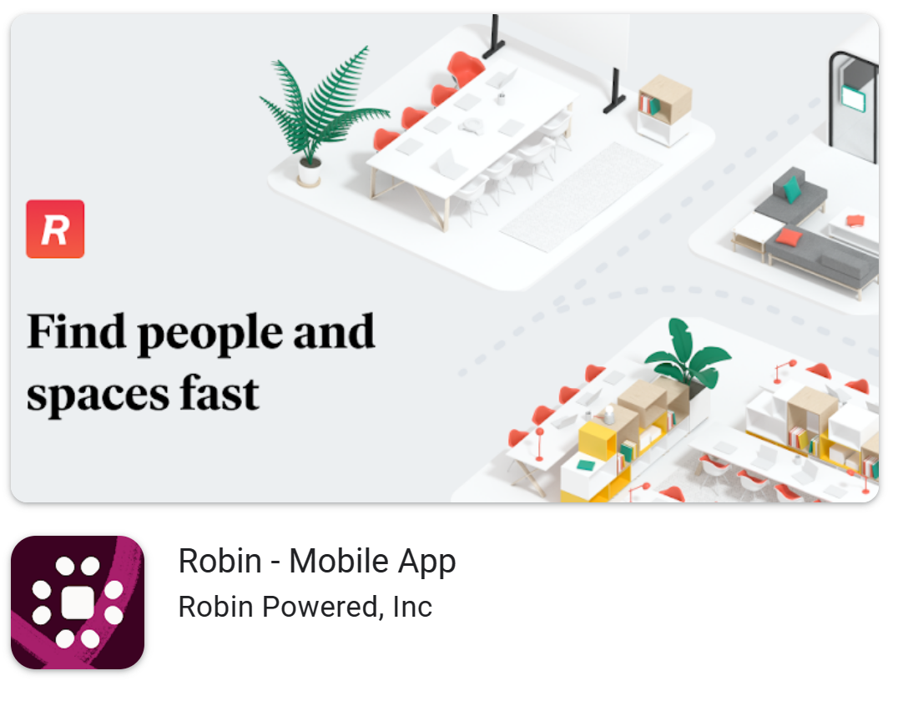
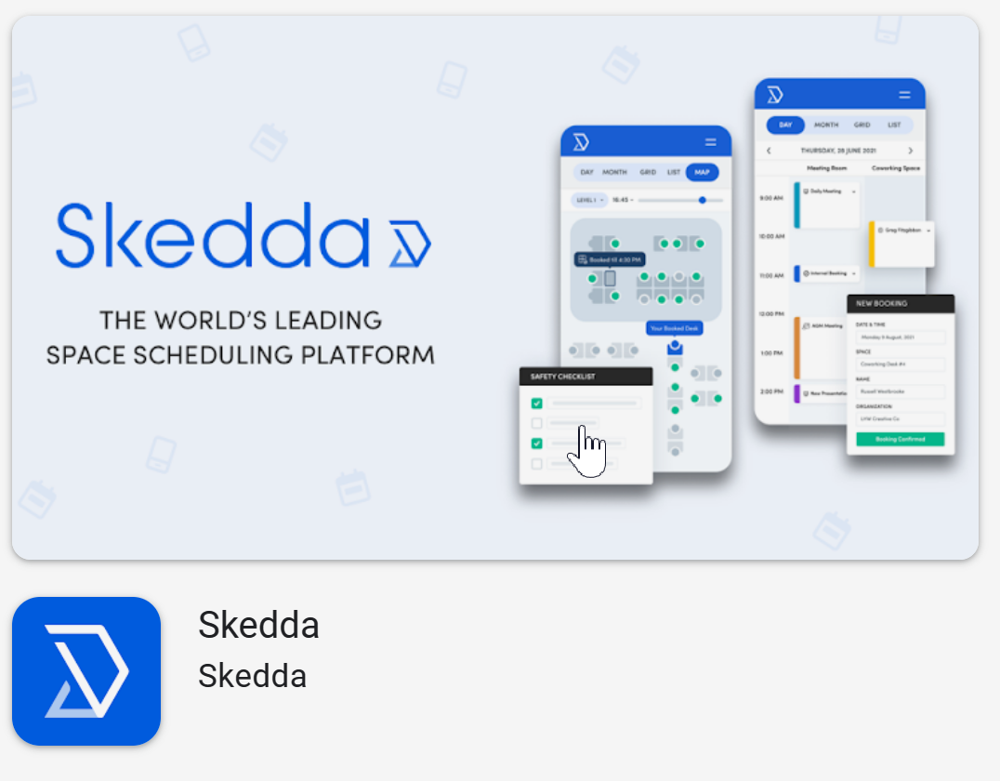
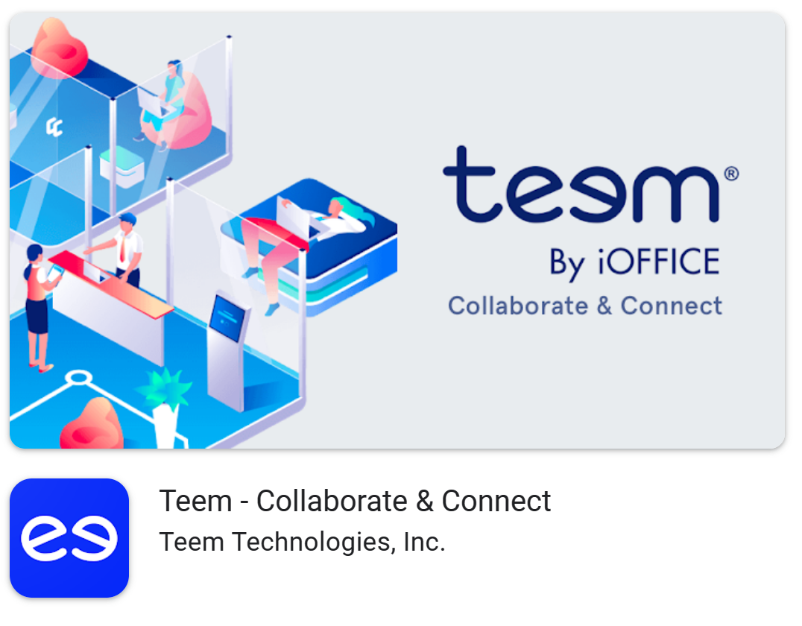
Market Research
Competitive Landscape:
Here are 9 similar apps in the room scheduling market:
Provides room scheduling and workplace management tools for offices.
A popular and user-friendly room scheduling platform.
Offers comprehensive workplace management solutions, including room scheduling.

Slide 4
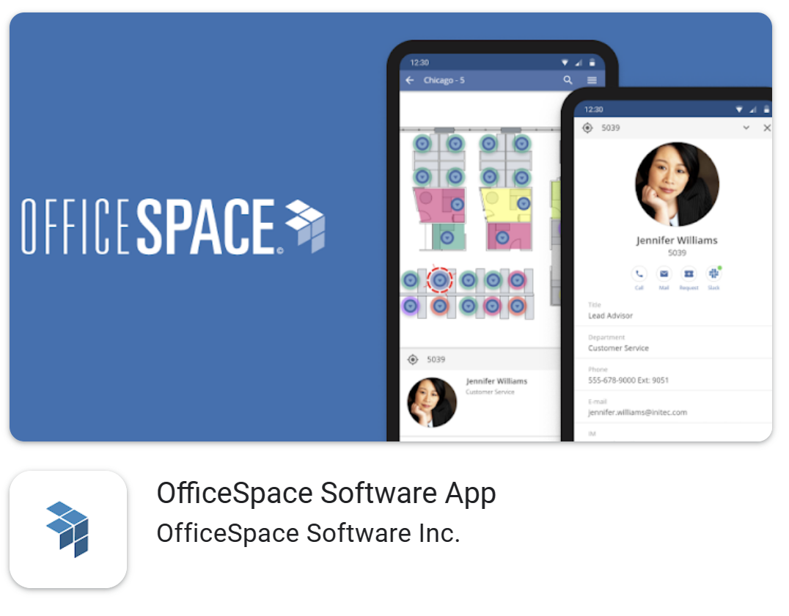
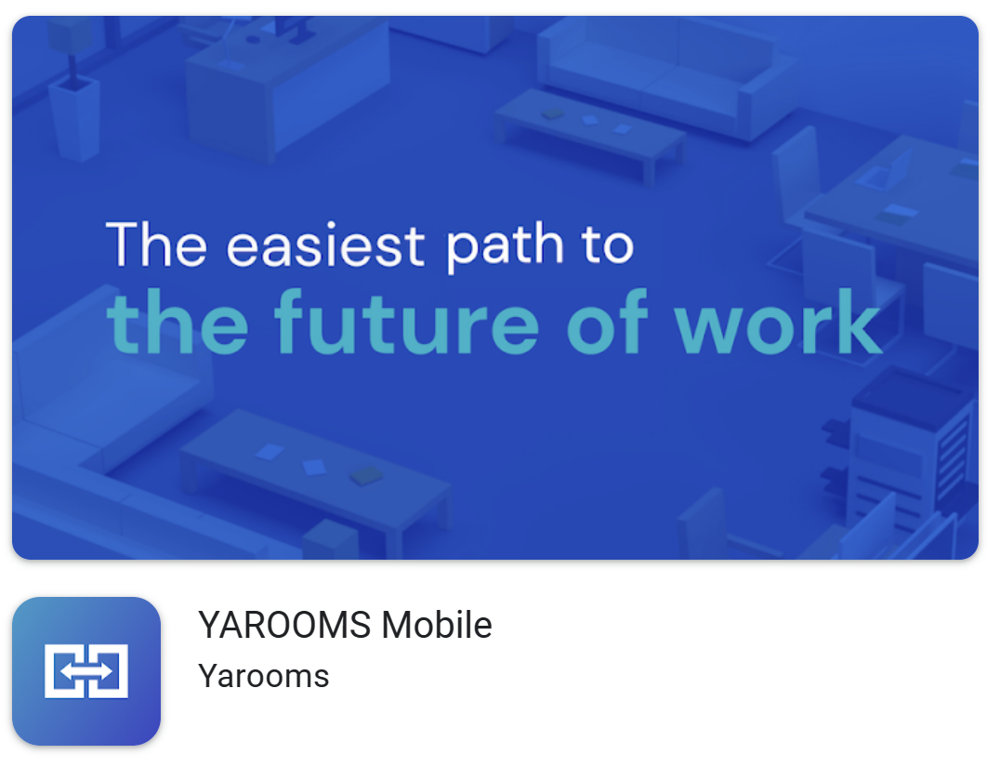
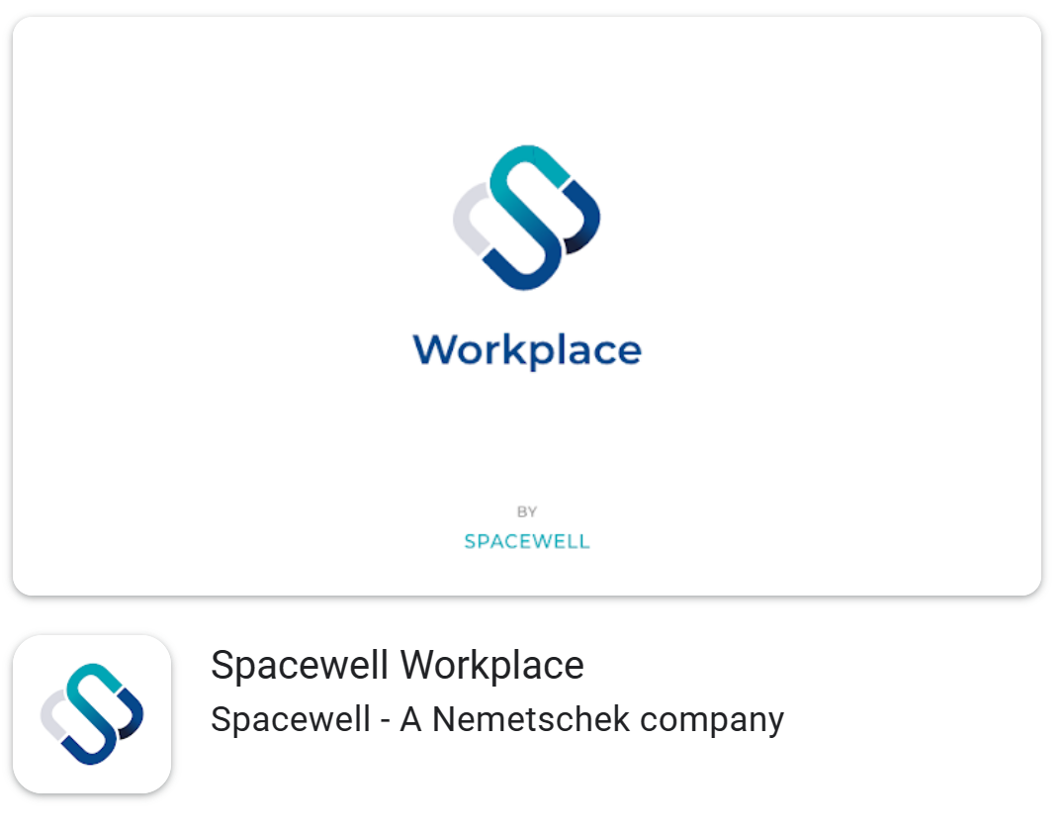
Market Research
Competitive Landscape:
Here are 9 similar apps in the room scheduling market:
Focuses on optimizing workplace management, including room bookings.
Offers room scheduling and resource management tools for businesses and organizations.
Provides room and workplace management software for large enterprises.

Slide 5
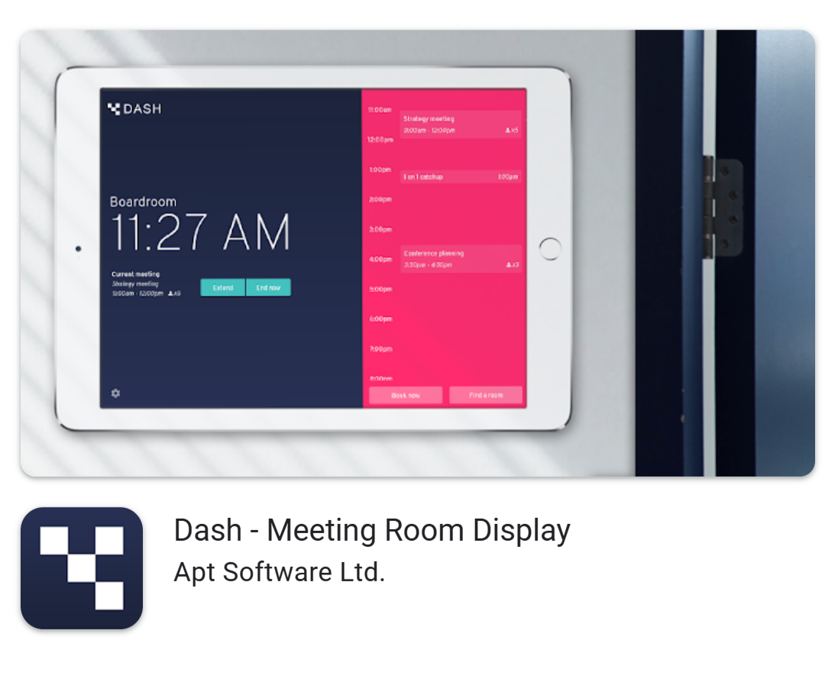

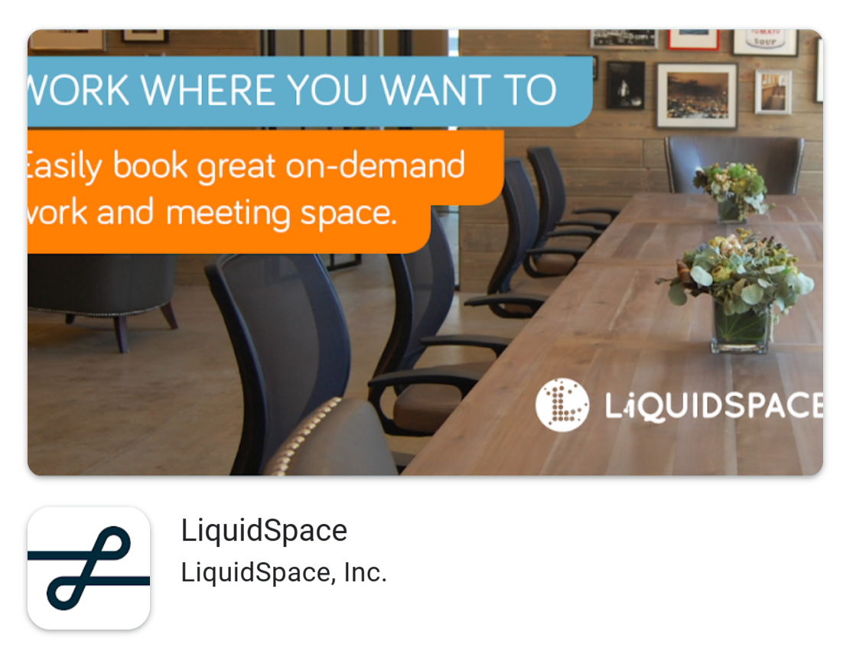
Market Research
Competitive Landscape:
Here are 9 similar apps in the room scheduling market:
Dash: Provides real-time information and scheduling capabilities for meeting rooms
allows users to create virtual workspaces, organize projects, and communicate.
LiquidSpace: connects users with flexible workspace options.

Slide 6
ScreenShots from the App:

Slide 7
Main Features
Here are the main features of BookBoard in a concise format:
1. Intuitive room scheduling interface for easy booking.
2. Real-time availability updates for accurate scheduling.
3. NFC tag validation for seamless reservation verification.
4. Notification and reminder system for timely updates.
5. Customizable booking policies to adapt to specific needs.

Slide 8

The Server Usage:
BookBoard utilizes Firebase, a powerful platform provided by Google, to enhance its functionality. Firebase offers a range of tools and services that seamlessly integrate with BookBoard's infrastructure. It leverages Firebase's real-time database for instant updates on room availability, authentication for secure user login, and push notifications for timely reminders. Firebase's analytics and crash reporting features provide valuable insights to improve the app's performance. Overall, Firebase enables BookBoard to deliver a seamless and reliable room scheduling experience to its users.

